Slide 1

Simulation Project -
Team Tetrahedron
Simulation Project - Team D
Milestone #6 - Validation
Milestone #6 - Validation
Image source: https://cdn.ottopix.de/wp-content/uploads/2019/04/Magdeburg-Panorama-%C3%BCber-der-Hubbr%C3%BCcke.jpg

Slide 2
Agenda
Simulation Project - Team D
Milestone #6 - Validation
01
02
Output Analysis
Validation
Verification of the output from the model.
Face validation of the model output.
05
So far
Progress made and cost incurred so far.
03
04
Changes
Limitations
Changes made to the model.
Difficulties faced which limit the scope of validation.

Slide 3
01
Output Analysis
Simulation Project - Team D
Milestone #6 - Validation
Verification of the output from the model.

Slide 4
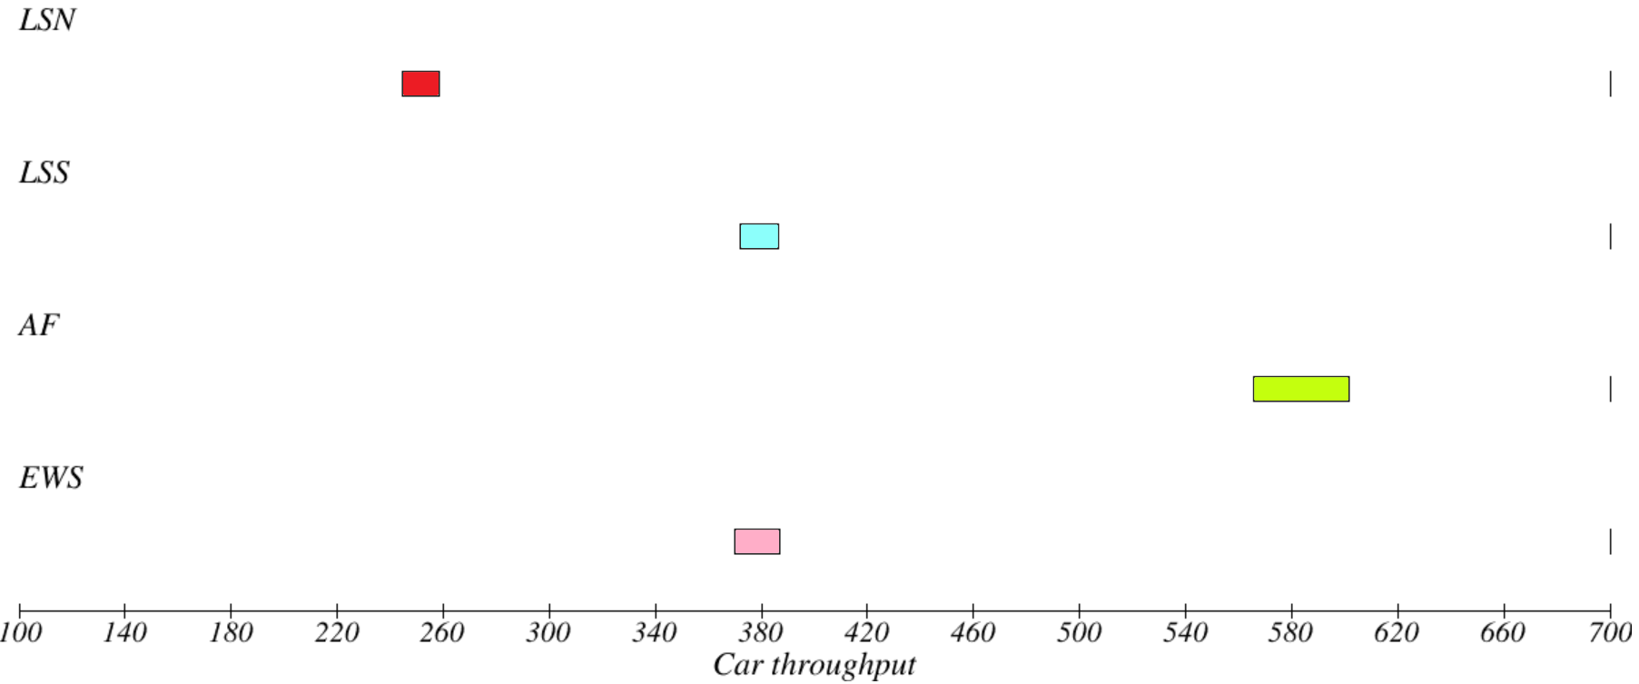
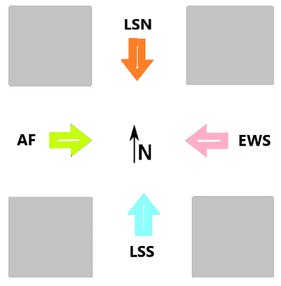
Simulation Project - Team D
Milestone #6 - Validation
Output measured
01
Car throughput measured at sink for each road.
02
Number of cars arriving the system measured at source.
tVal = 2.8713076
alpha = 0.05
dof = 99

Slide 5
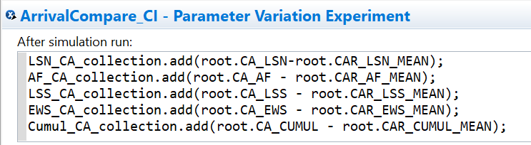
Arrival Compare Experiment
01
02
03
Simulation Project - Team D
Milestone #6 - Validation
Number of cars arriving each road.
Mean expected number of cars per road (Model time / distribution).
Difference between measured and expected should ideally include zero to fit the distribution.

Slide 6
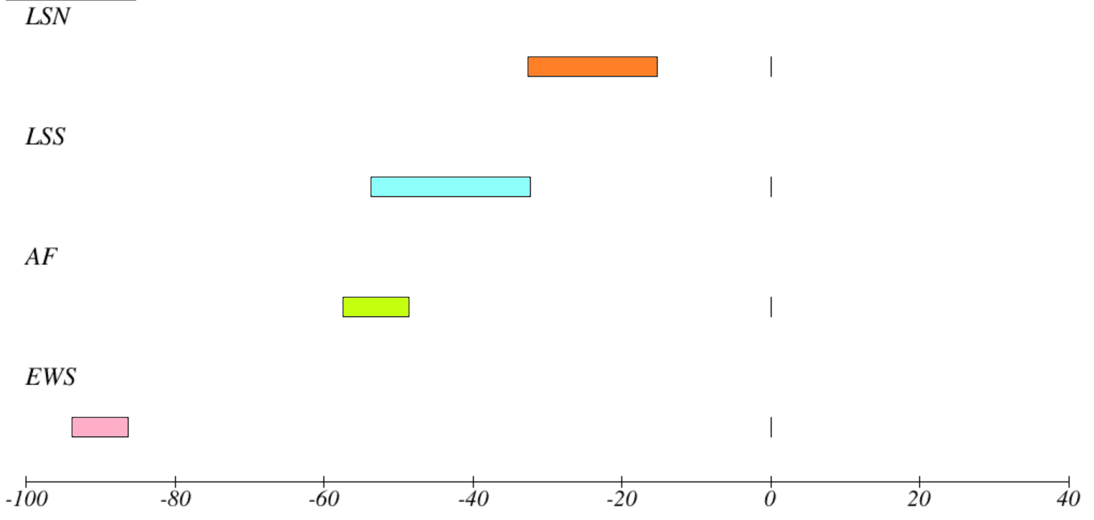
Simulation Project - Team D
Milestone #6 - Validation
Result
tVal = 2.8713076
alpha = 0.05
dof = 99

Slide 7
02
Validation
Simulation Project - Team D
Milestone #6 - Validation
Face validation of the model output.

Slide 8
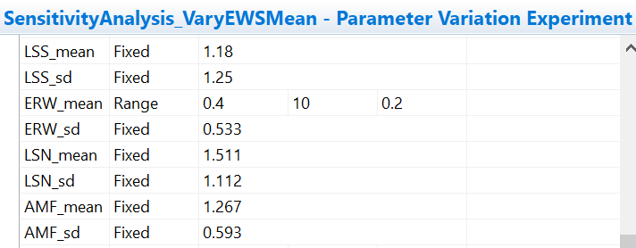
Sensitivity Analysis
01
02
03
Simulation Project - Team D
Milestone #6 - Validation
Dependency of output values on input parameters.
Output = Mean and standard deviation of throughput.
Input = Mean and standard deviation of inter-arrival time.

Slide 9
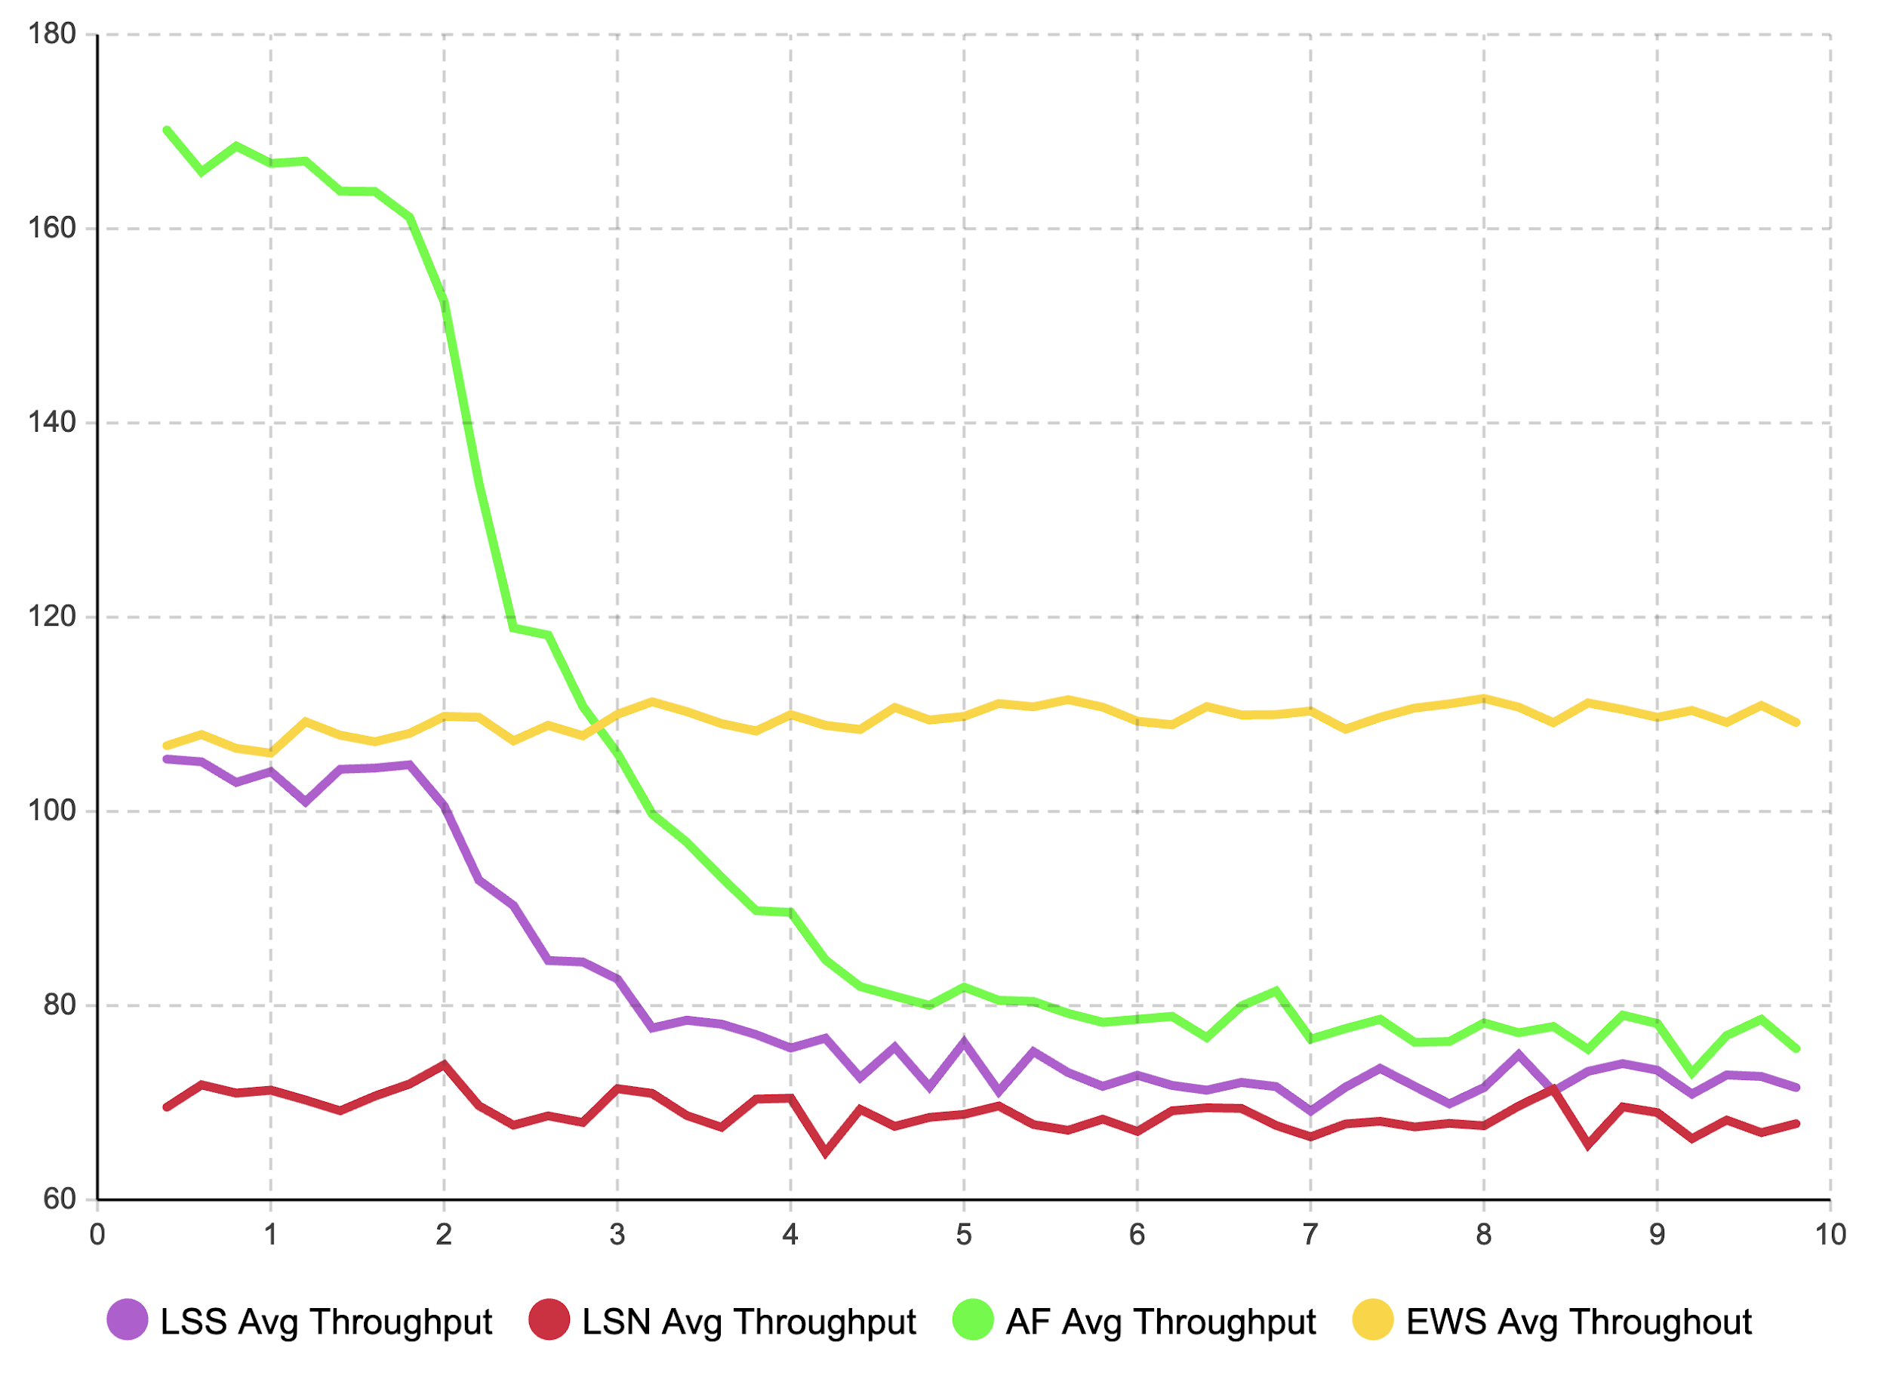
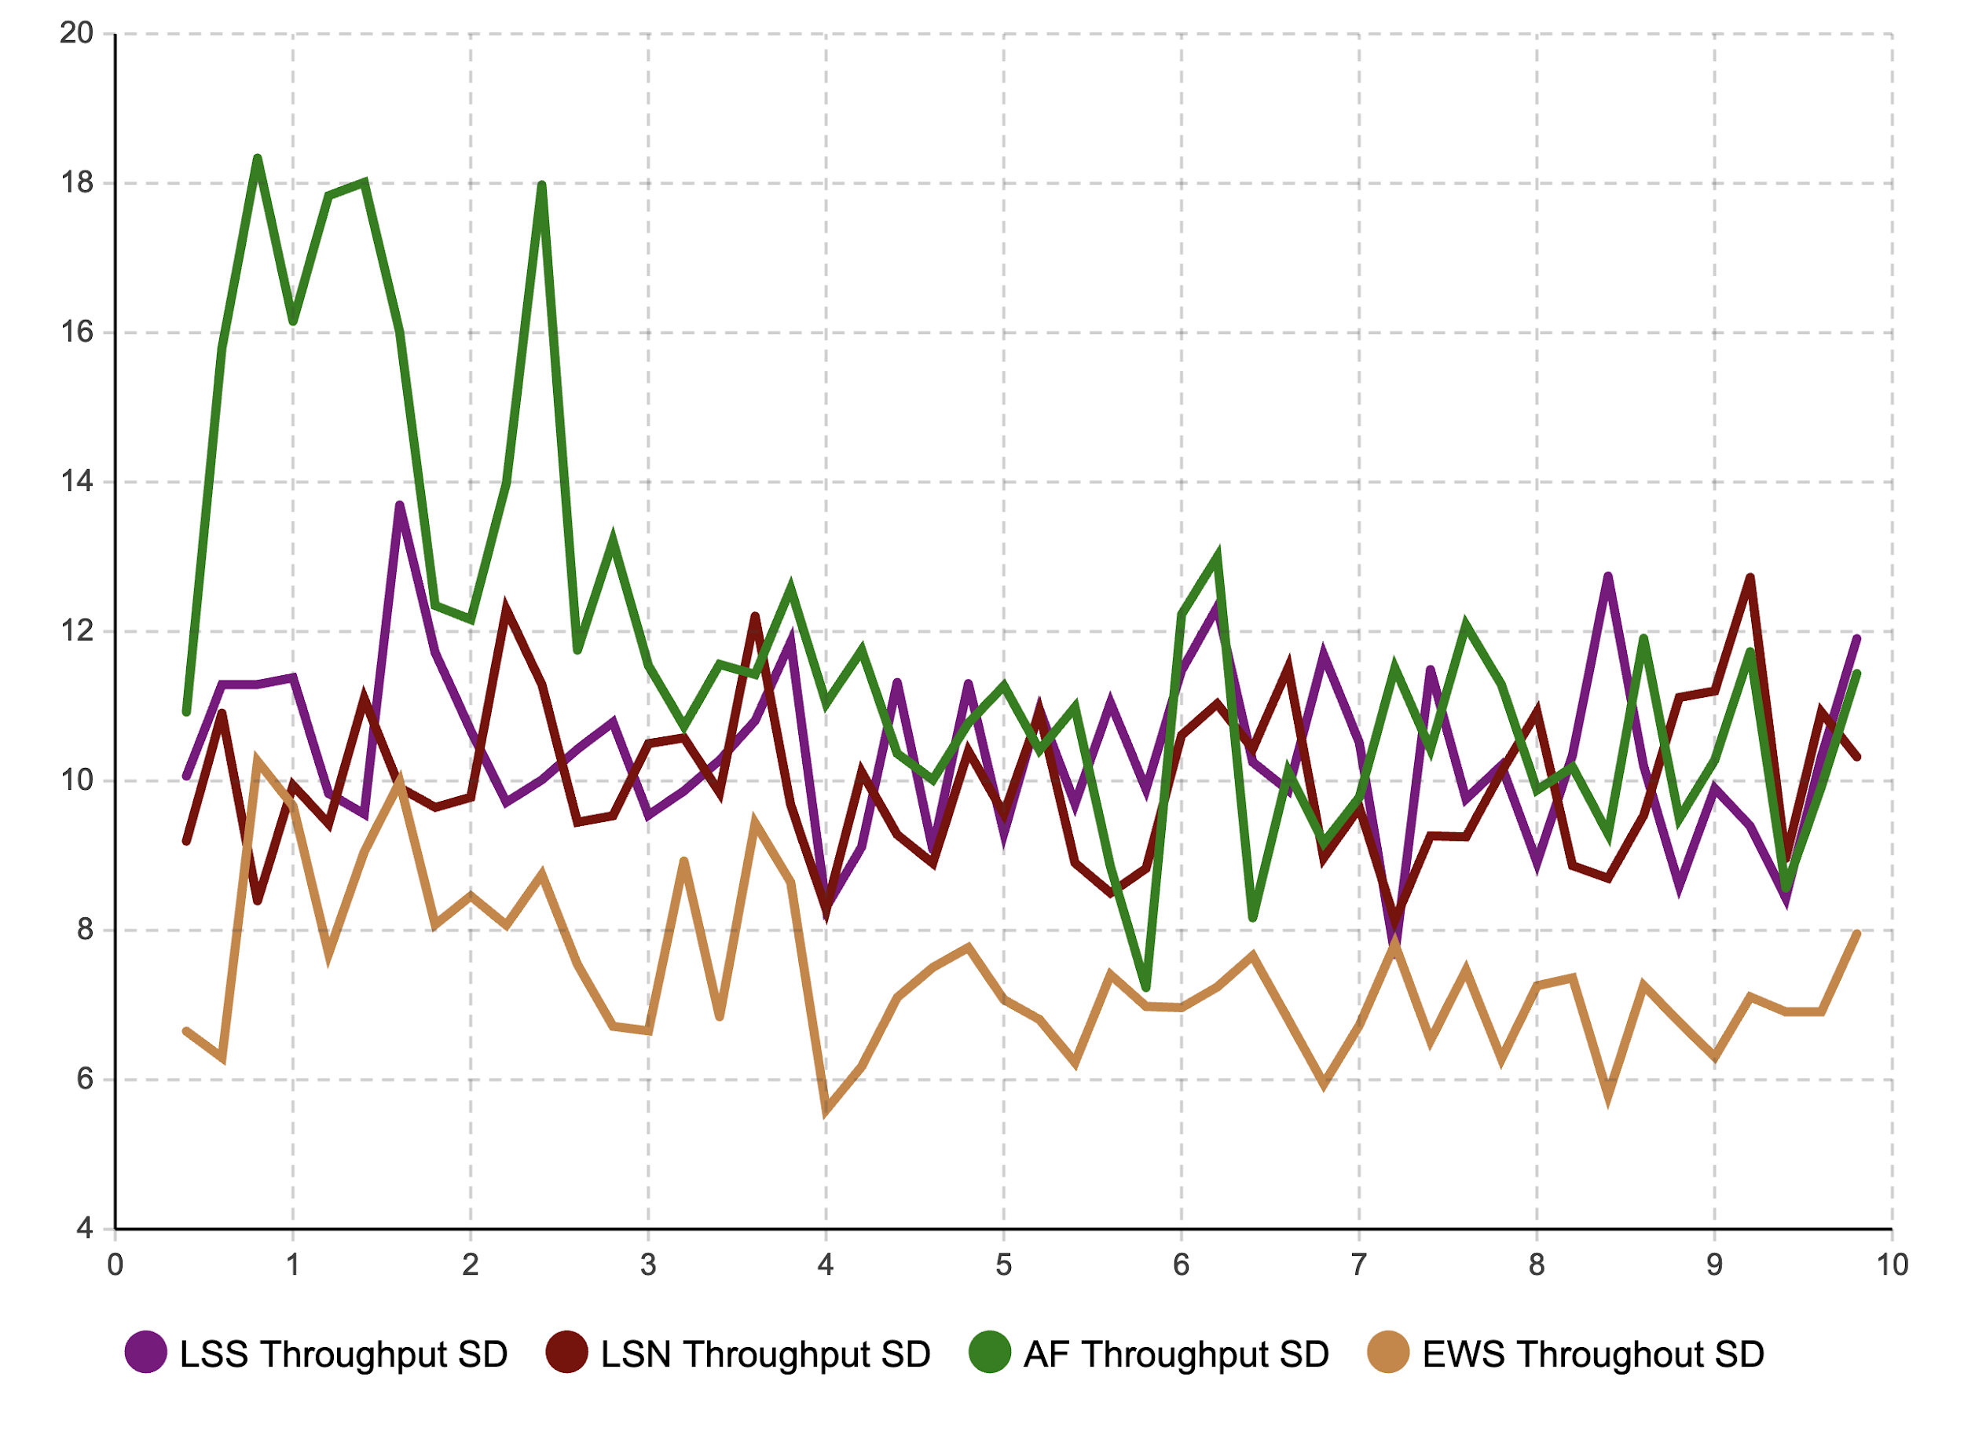
Simulation Project - Team D
Milestone #6 - Validation
Result (Vary EWS Mean)

Slide 10
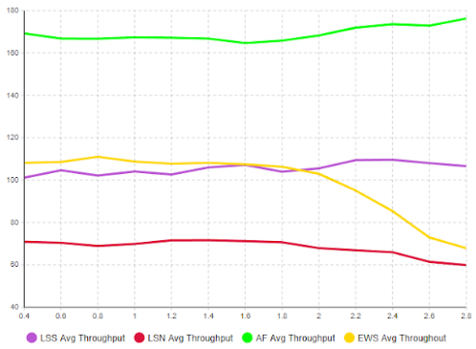
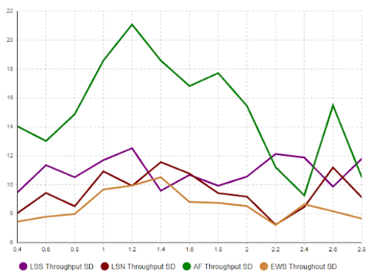
Simulation Project - Team D
Milestone #6 - Validation
Result (Vary AF mean)

Slide 11
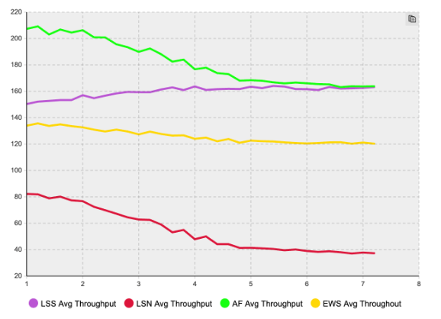
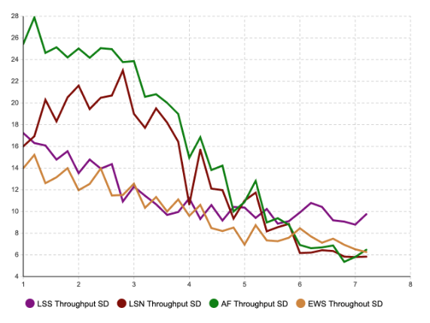
Simulation Project - Team D
Milestone #6 - Validation
Result (Vary LSS mean)

Slide 12
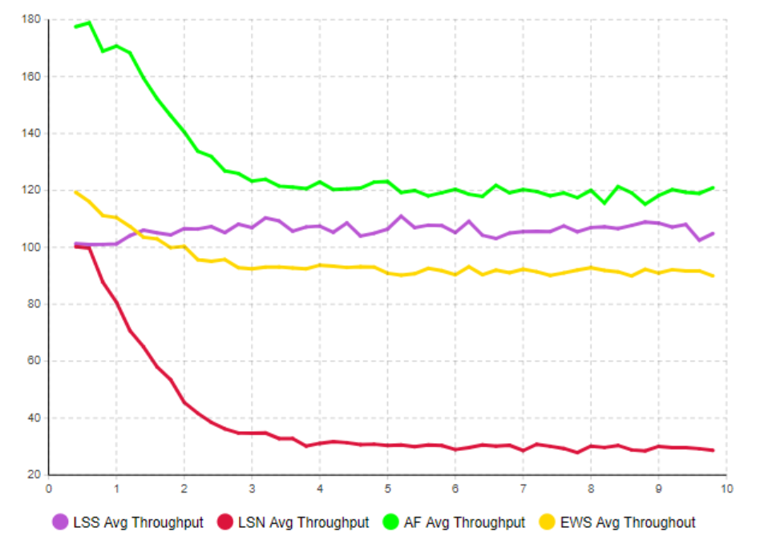
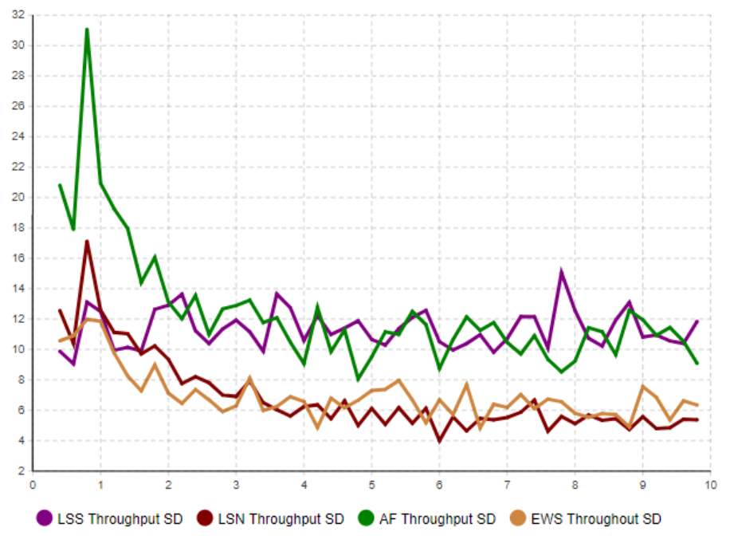
Simulation Project - Team D
Milestone #6 - Validation
Result (Vary LSS standard deviation)

Slide 13
03
Changes
Simulation Project - Team D
Milestone #6 - Validation
Changes made to the model.

Slide 14
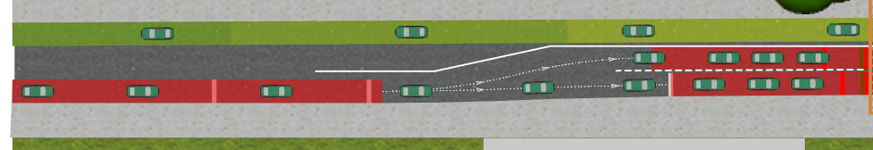
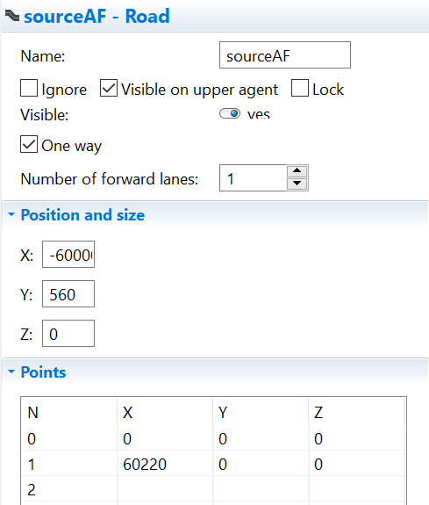
Simulation Project - Team D
Milestone #6 - Validation
01
Migrated the system to use variables for all parameters and outputs.
02
Reviewed traffic light phases with collected data.
03
Extended the roads long enough to avoid cars piling up.
04
Changed distribution with another model to fit Magdeburg data.

Slide 15
04
Limitations
Simulation Project - Team D
Milestone #6 - Validation
Difficulties faced which limit the scope of validation.

Slide 16
01
02
03
04
Simulation Project - Team D
Milestone #6 - Validation
Wasted a lot of budget on the model trying to fit the distribution.
Last year’s input data is unrealistic.
No inter-arrival time in Magdeburg data for data analysis of the second model.
Running the experiments is time consuming.

Slide 17
05
So far
Simulation Project - Team D
Milestone #6 - Validation
Progress made and costs incurred so far.

Slide 18
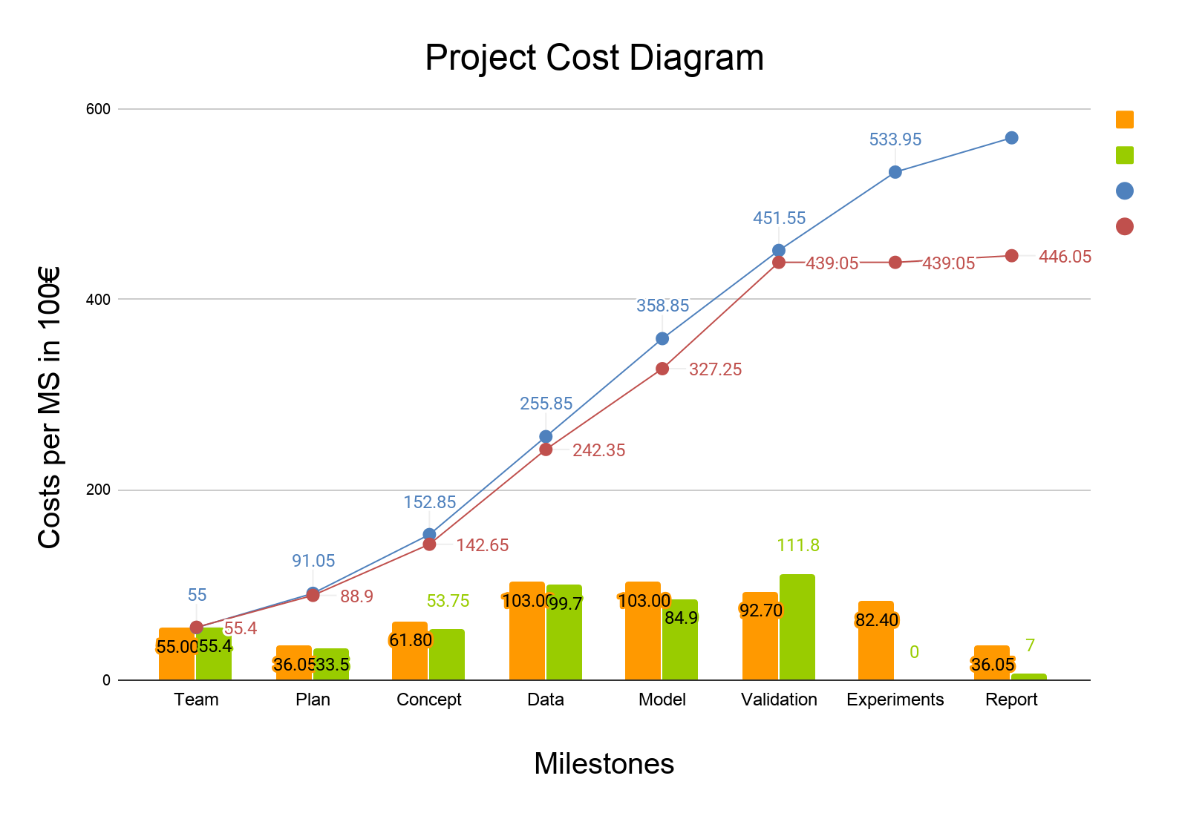
Cost incurred
Simulation Project - Team D
Milestone #6 - Validation
Estimated cost
Actual cost
Cumulative estimate
Cumulative actual

Slide 19
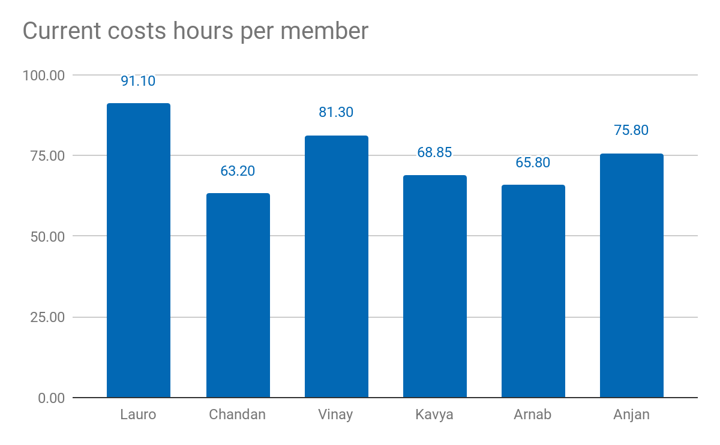
Current costs as % of total cost: 74.34%
Current costs: 44.605,00 €
Simulation Project - Team D
Milestone #6 - Validation

Slide 20
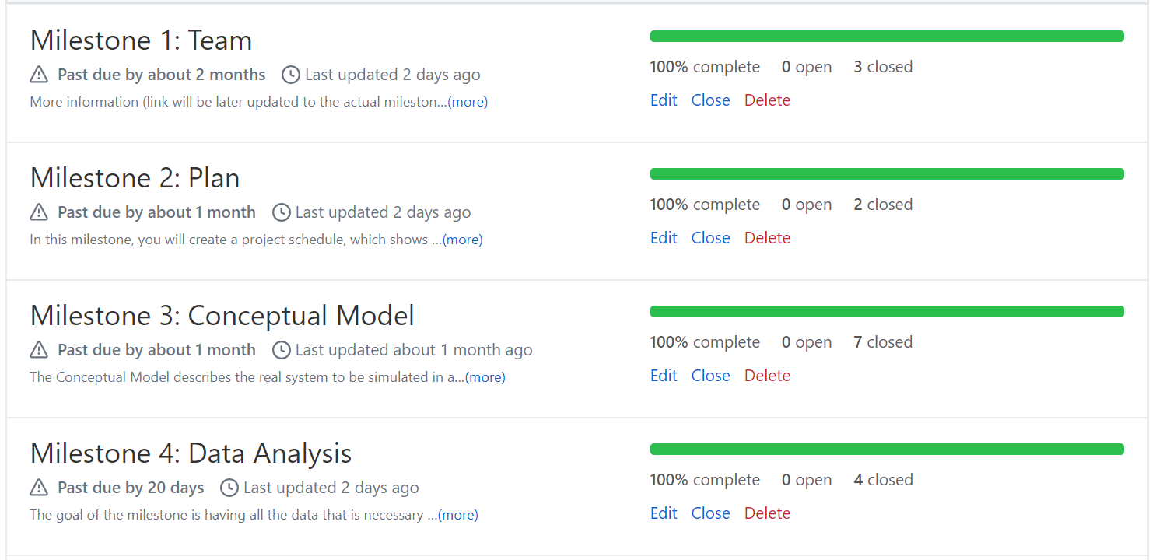
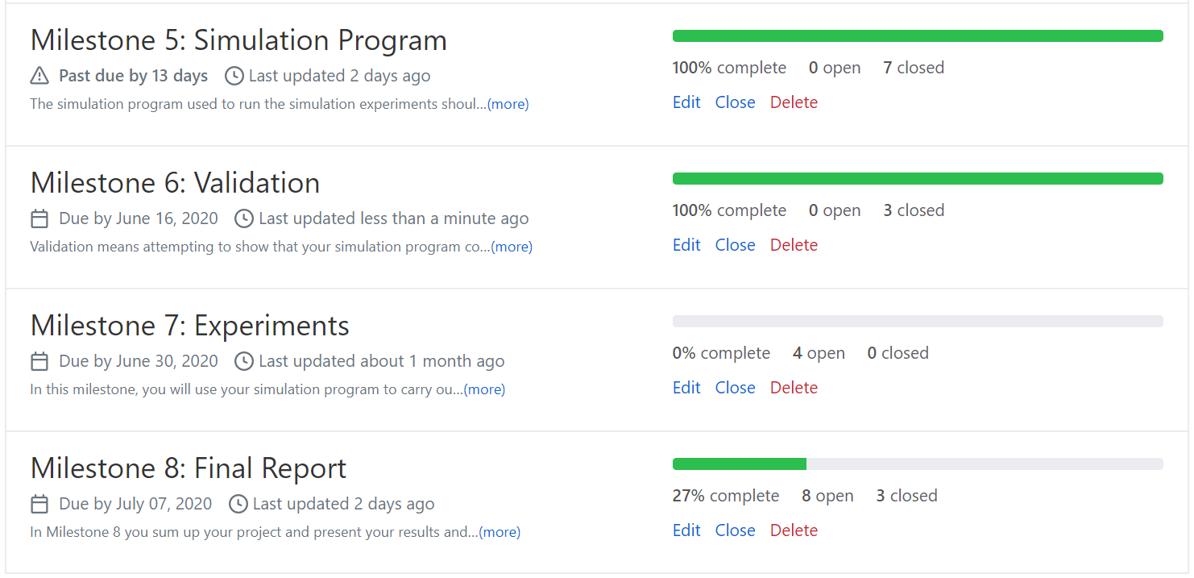
Progress made
Simulation Project - Team D
Milestone #6 - Validation

Slide 21
Tasks completed so far
✓
✓
✓
✓
Simulation Project - Team D
Milestone #6 - Validation
Update work as issues in GitHub.
Started working on experiments.
Final report is running parallely.
Decided on having two models

Slide 22
Lessons learned
01
02
03
04
Simulation Project - Team D
Milestone #6 - Validation
Include the progress made slide
Validation takes up a lot of time
Version control is important for any team project
Update worksheet evenly throughout the week

Slide 23
06
Thank you!
Simulation Project - Team D
Milestone #6 - Validation
Questions?

